Slide 1
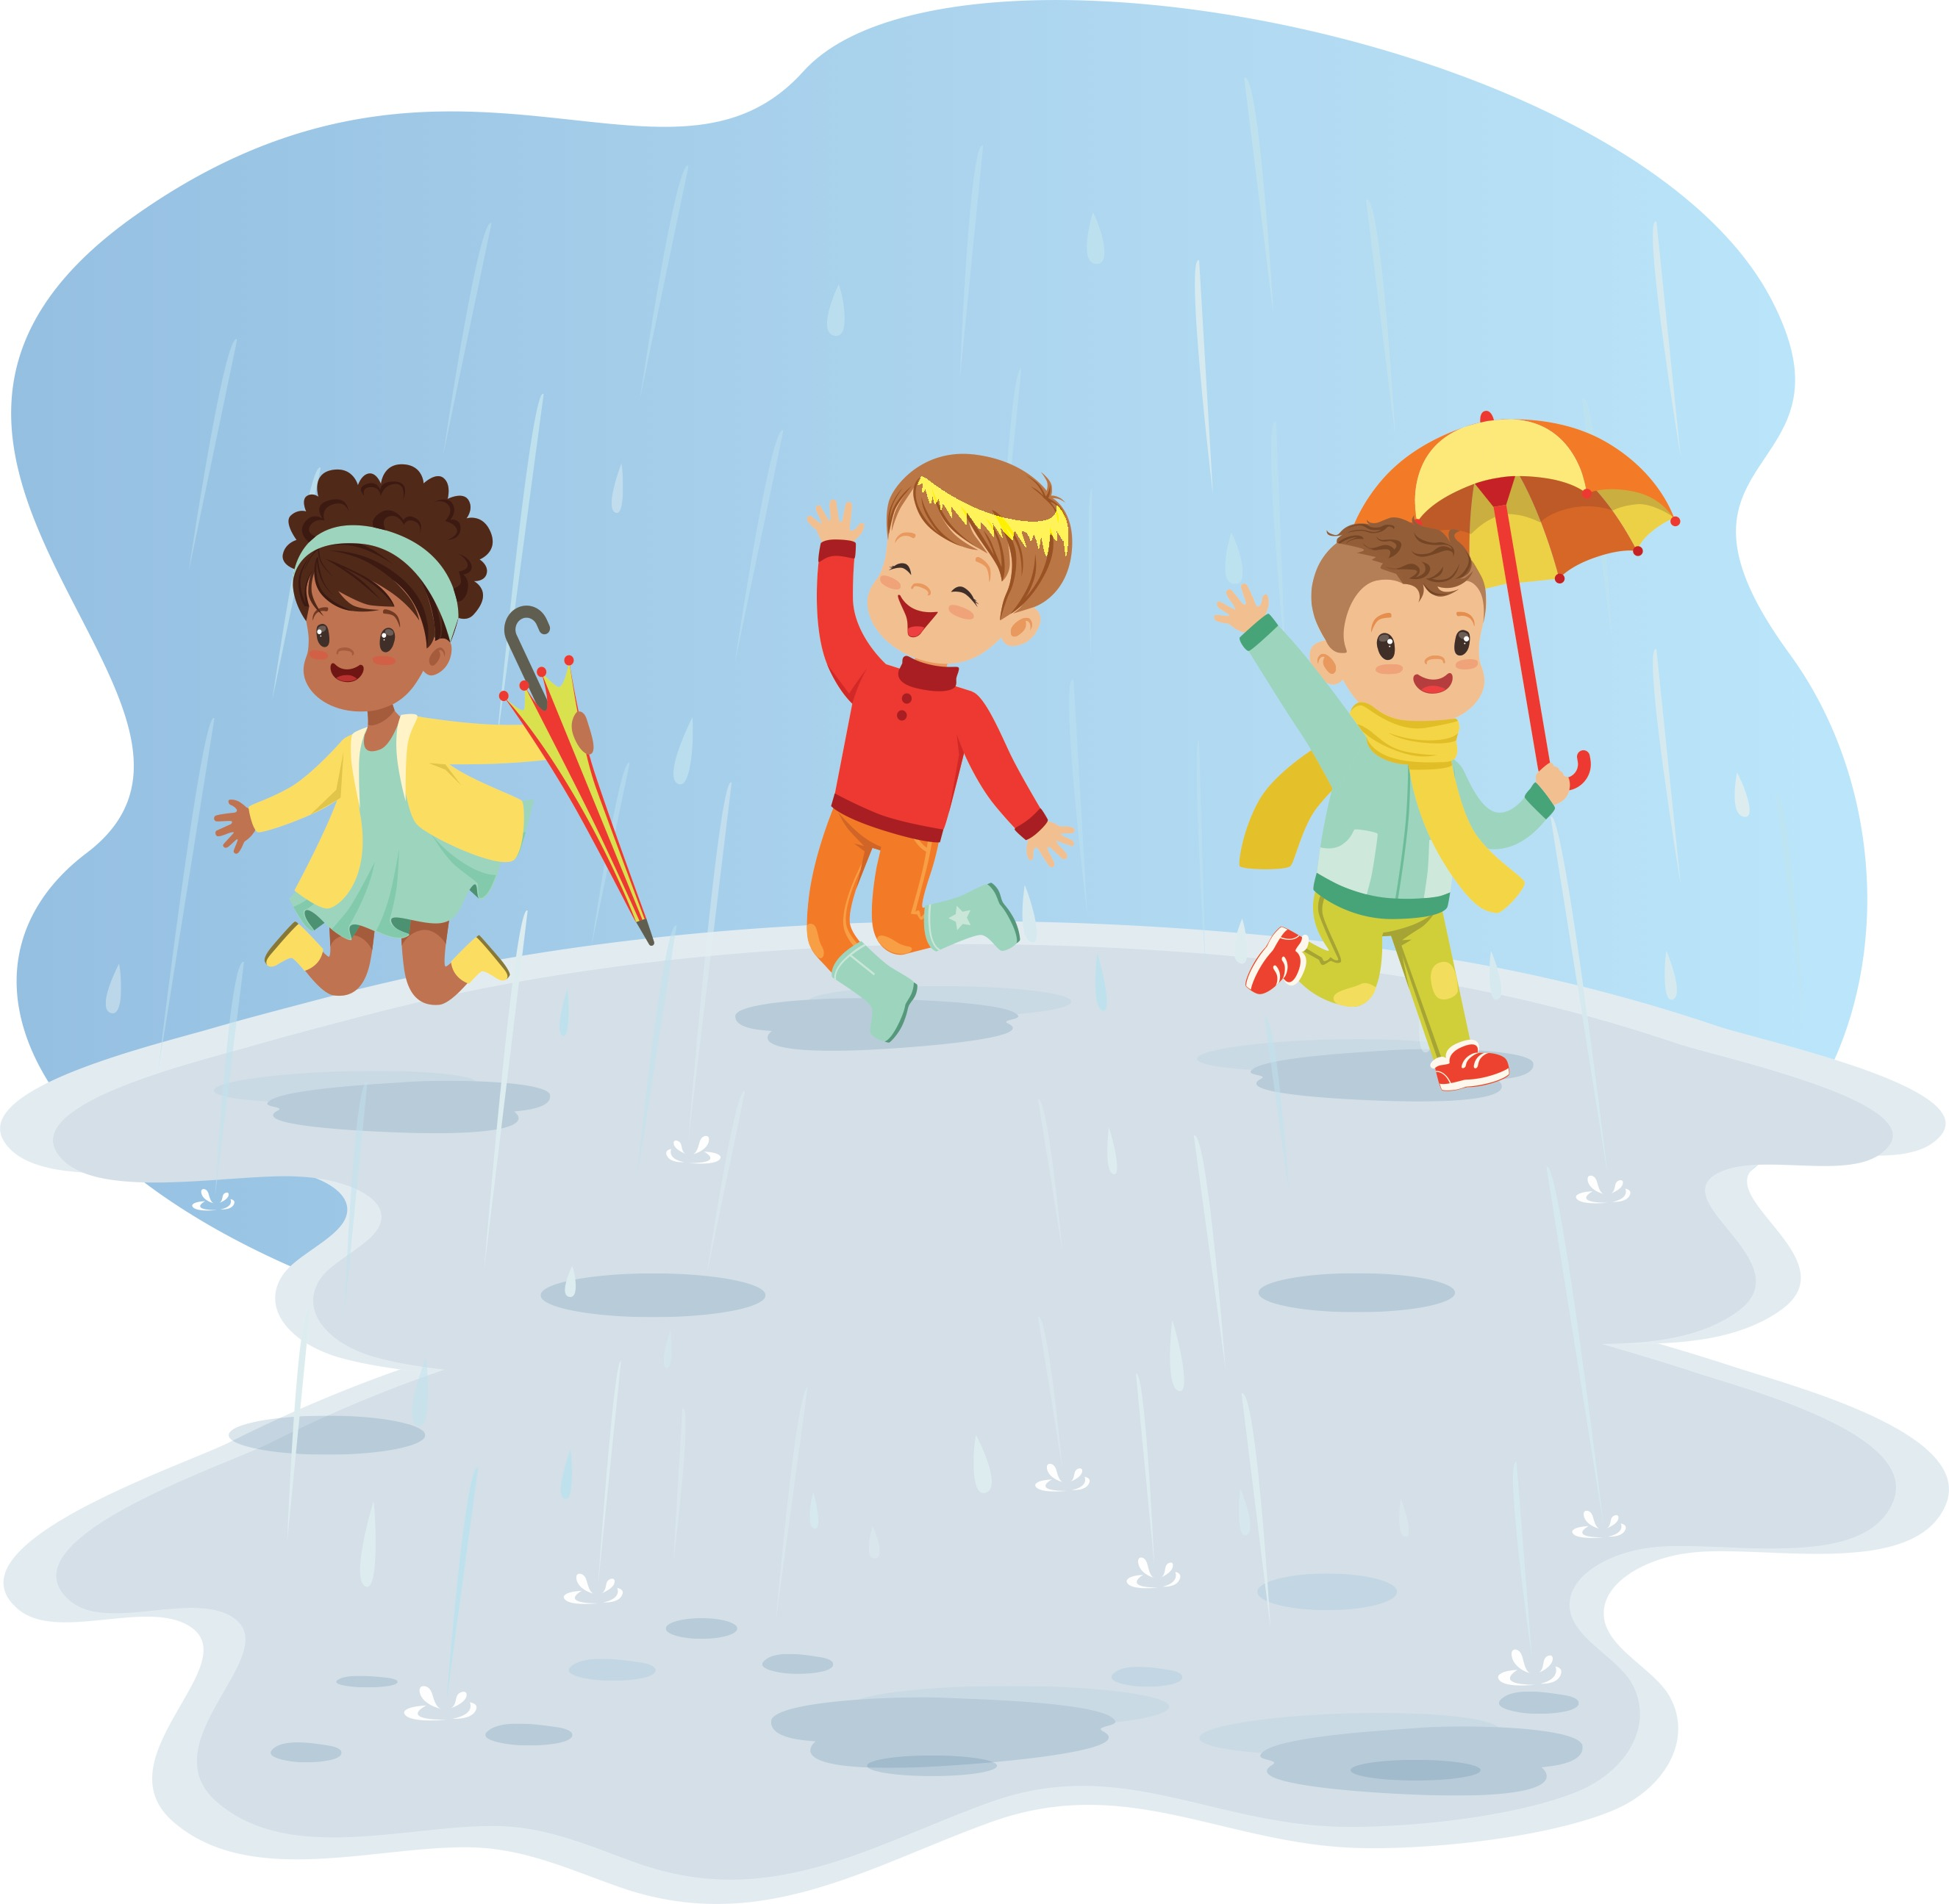

Dè bhios sinn ag iarraidh
nuair a bhios sinn a-muigh?
Notes:
What do we need when we are outside?

Slide 2

Ma bhios an t-sìde fuar, bidh feum againn air…
Notes:
If the weather is cold, we need…

Slide 3
bòtannan
Notes:
boots

Slide 4
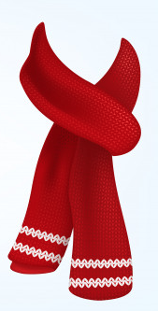
sgarfa
Notes:
scarf

Slide 5
ad
Notes:
hat

Slide 6
còta
Notes:
coat

Slide 7
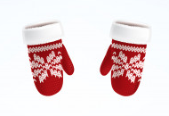
miotagan
Notes:
gloves

Slide 8

Ma bhios an t-sìde fliuch, bidh feum againn air…
Notes:
If the weather is wet, we need…

Slide 9
bòtannan
Notes:
boots

Slide 10
còta-froise
Notes:
Rain coat

Slide 11
sgàilean
Notes:
umbrella

Slide 12

Ma bhios an t-sìde grianach, bidh feum againn air…
Notes:
If the weather is sunny, we need…

Slide 13
ceap
Notes:
hat

Slide 14
speuclairean dubha
Notes:
sunglasses

Slide 15
briogais ghoirid
Notes:
shorts

Slide 16
lèine-t
Notes:
T shirt

Slide 17
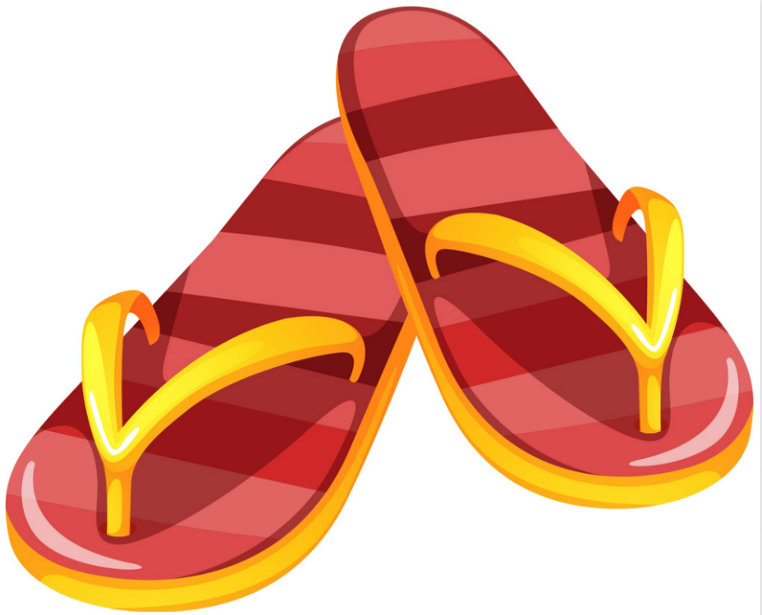
cuaranan
Notes:
sandals

Slide 18

cè-grèine
Notes:
Sun cream

